Slide 1


The Machine Learning Process

Slide 2




The Machine Learning Process
Data Pre-Processing
Import the data
Clean the data
Split into training & test sets
Feature Scaling
Modelling
Build the model
Train the model
Make predictions
Evaluation
Calculate performance metrics
Make a verdict

Slide 3


Training Set & Test Set

Slide 4
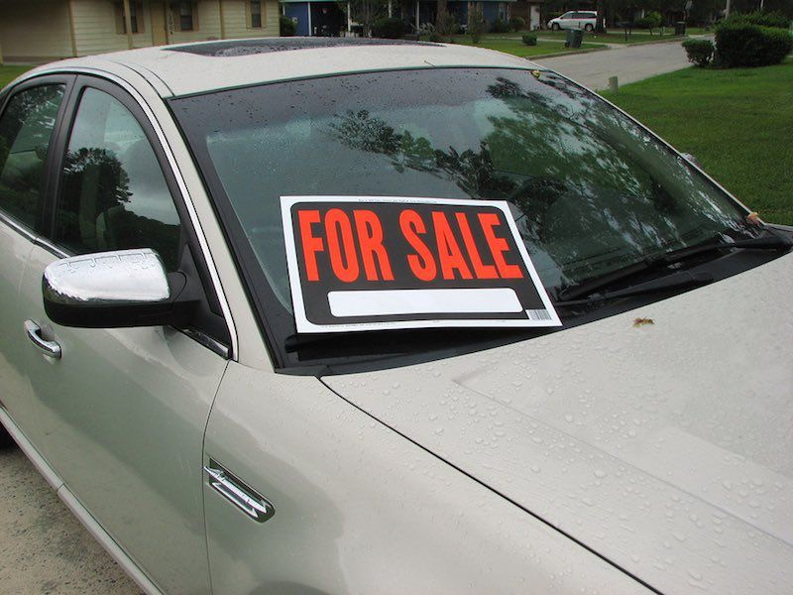








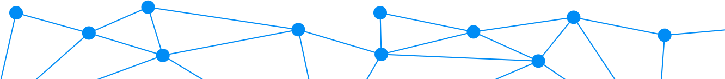
Training Set & Test Set
Training Set and Test set
~
Train 80%
𝑦 ‘= 𝑏₀ + 𝑏₁𝑋₁ + 𝑏₂𝑋₂
Test 20%
V.S.
Predicted values 𝑦i
Actual values 𝑦

Slide 5
Feature Scaling

Slide 6
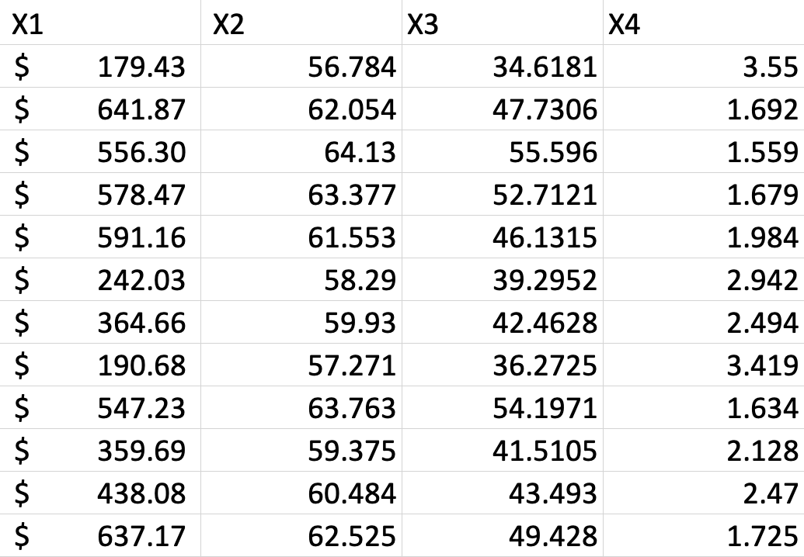
Feature Scaling
Feature Scaling

Slide 7
Feature Scaling
Normalization
Standardization
Normalization
Standardization
𝑋 − 𝑋_{min}
_{𝑋' =} 𝑋 − 𝜇
𝜎
[-3 ; +3]
𝑋' =
^{𝑋max} ^{− 𝑋min}
[0 ; 1]

Slide 8




Feature Scaling
Feature Scaling
70,000 $
10,000
60,000 $
8,000
52,000 $
45 yrs
1
44 yrs
4
40 yrs

Slide 9
Feature Scaling
Feature Scaling
Normalization
Normalization
𝑋 − 𝑋_{min}
𝑋' =
^{𝑋max} ^{− 𝑋min}
[0 ; 1]

Slide 10
Feature Scaling
Feature Scaling
70,000 $ | 45 yrs
60,000 $ | 44 yrs
52,000 $ | 40 yrs

Slide 11
Feature Scaling
Feature Scaling
1
0.444
0
45 yrs
44 yrs
40 yrs

Slide 12
Feature Scaling
Feature Scaling
1 | 1
0.444 | 0.75
0 | 0

Slide 13


Regression

Slide 14
Simple Linear Regression

Slide 15
SiSimple Linear Regressionmple Linear Regression
𝑦 ' = 𝑏₀+ 𝑏₁𝑋₁
Dependent variable
Independent variable
y-intercept (constant)
Slope coefficient

Slide 16
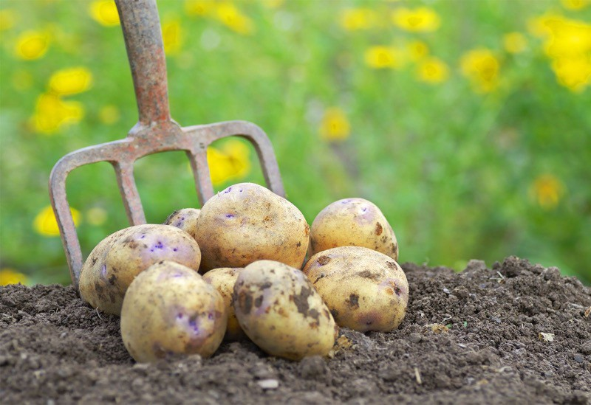


Simple Linear Regression
SiSimple Linear Regressionmple Linear Regression
Each point represents a separate harvest
𝑦 [tonnes] (Potato yield)
~
𝑦 ‘ = 𝑏₀ + 𝑏₁𝑋₁
𝑃𝑜𝑡𝑎𝑡𝑜𝑒𝑠 [𝑡] = 𝑏₀ + 𝑏₁×𝐹𝑒𝑟𝑡𝑖𝑙𝑖𝑧𝑒𝑟 [𝑘𝑔]
+3𝑡
8𝑡
𝑏_{i} = 8[𝑡]
𝑡
𝑏1 = 3[ ]
+1𝑘𝑔
𝑋_{i} [kg] (Nitrogen Fertilizer)
"
𝑘𝑔

Slide 17
Ordinary Least Squares

Slide 18
Simple Linear Regression
SiSimple Linear Regressionmple Linear Regression
𝑦 [tonnes] (Potato yield)
Ordinary Least Squares:
𝑦_{i}
𝑟𝑒𝑠𝑖𝑑𝑢𝑎𝑙: 𝜀i = 𝑦i – yi’
yi’
𝑦_{I}
_{Yi’}
𝑦 '= 𝑏₀ + 𝑏₁𝑋₁
𝑏₀, 𝑏₁ such that:
𝑆𝑈𝑀(𝑦_{i} − 𝑦_{ii’})² is minimized
𝑋_{i} [kg] (Nitrogen Fertilizer)

Slide 19
Multiple Linear Regression

Slide 20
MMultiple Linear Regressionultiple Linear Regression
𝑦 '= 𝑏₀ + 𝑏₁𝑋₁ + 𝑏₂𝑋₂ + ⋯ + 𝑏_{n}𝑋_{n}
Dependent variable
Independent variable 1
Independent variable 2
Independent variable n
y-intercept (constant)
Slope coefficient 1
Slope coefficient 2
Slope coefficient n

Slide 21


Multiple Linear Regression
MMultiple Linear Regressionultiple Linear Regression
~
𝑃𝑜𝑡𝑎𝑡𝑜𝑒𝑠[𝑡] = 8𝑡 + 3 t ×𝐹𝑒𝑟𝑡𝑖𝑙𝑖𝑧𝑒𝑟[𝑘𝑔]− 0.54 ^{t} ×𝐴𝑣𝑔𝑇𝑒𝑚𝑝 °𝐶 + 0.04
kg °c
t
×𝑅𝑎𝑖𝑛[𝑚𝑚]
mm

Slide 22
Assumptions Of Linear Regression

Slide 23
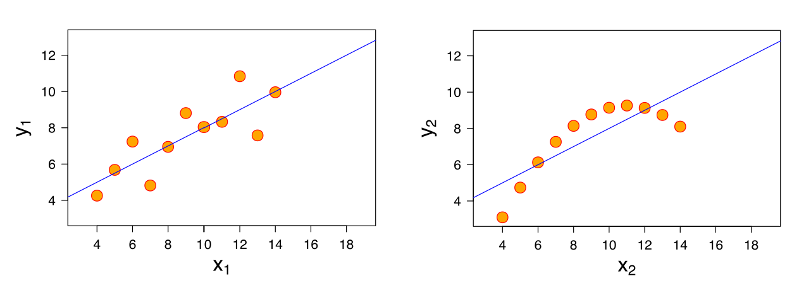


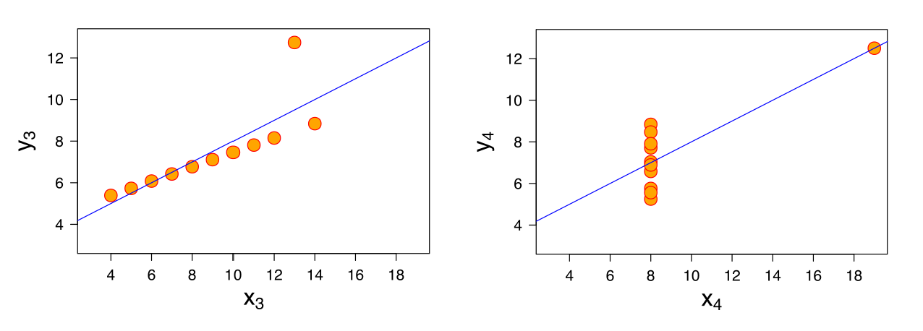
AAssumptions Of Linear Regressionssumptions of Linear Regression
Anscombe's quartet (1973):

Slide 24




Assumptions of Linear Regression
AAssumptions Of Linear Regressionssumptions of Linear Regression
1. Linearity
(Linear relationship between Y and each X)
2. Homoscedasticity
(Equal variance)
3. Multivariate Normality
(Normality of error distribution)
4. Independence
(of observations. Includes “no autocorrelation”)
5. Lack of Multicollinearity
(Predictors are not correlated with each other)
𝑋"~ 𝑋# 𝑋"~ 𝑋#
6. The Outlier Check
(This is not an assumption, but an “extra”)

Slide 25








Slide 26











X₃
X₄
X₅
X₂
X₆
X₁
y
X₇
Why?

Slide 27
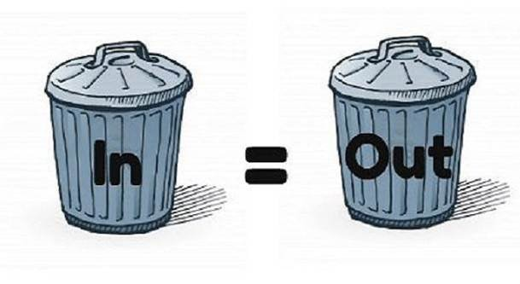
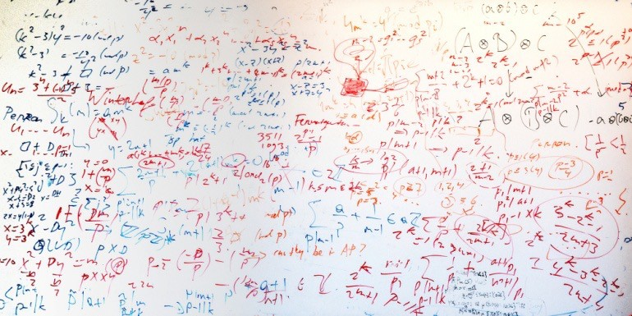
1)
2)

Slide 29


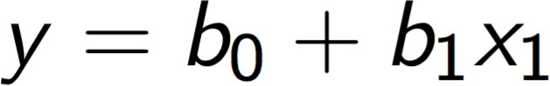
Simple Linear
Regression
Multiple Linear
Regression
Polynomial Linear
Regression

Slide 30




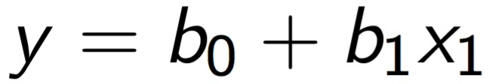


y
x1

Slide 31






y
x1

Slide 32





y
x1

Slide 33




Polynomial Linear
Regression

Slide 34



Slide 35





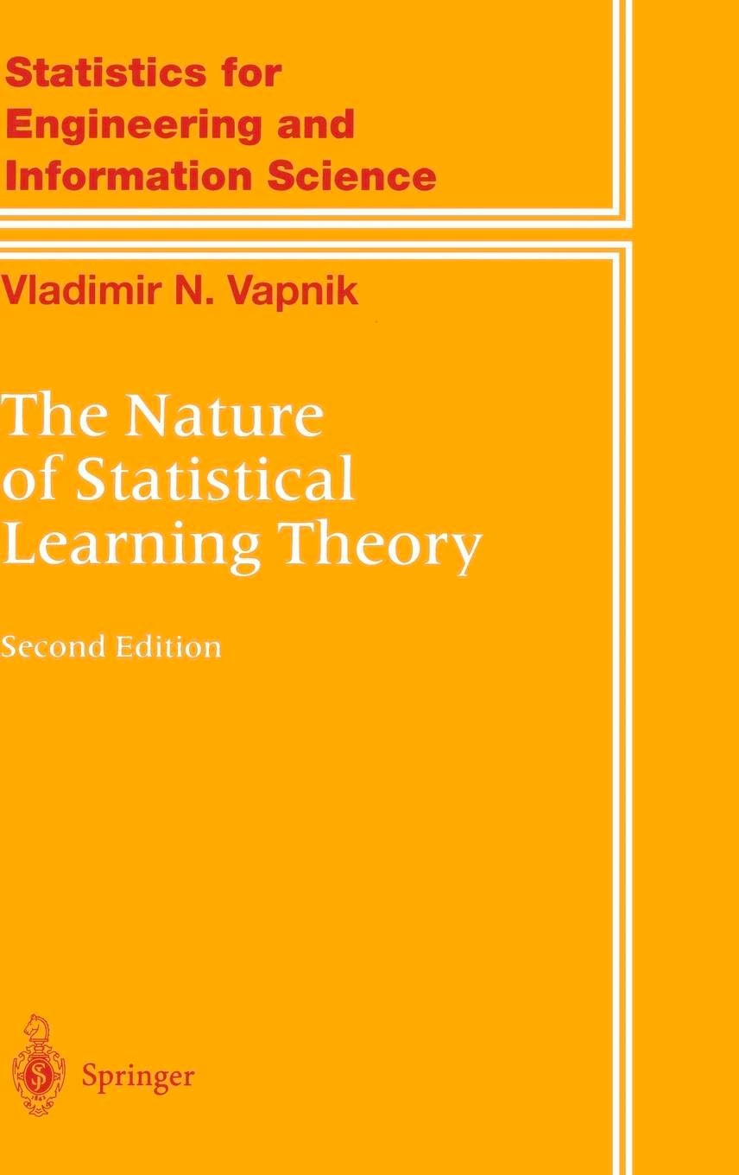
1992
Vladimir Vapnik

Slide 36
ε-Insensitive Tube
Ordinary Least Squares SUM (y – ŷ)² -> min
x2
x2
ε ε
x1
x1

Slide 37
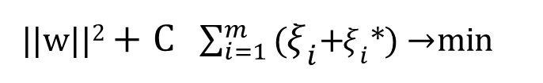
1
2
||w||²+C $\sum_{i=1}^{m}{\text{(}{\text{ξ}}_{i}\text{+}{\text{ξ}}_{i}\text{∗}\text{)}}$→ min
Ordinary Least Squares SUM (y – ŷ)² -> min
ε-Insensitive Tube Slack Variables ξi and ξi*
x2
x2
ε ε
ξ₅
ξ₃
ξ₂
*
ξ₄
ξ₁
*
x1
x1

Slide 38







Slide 39



x2
ε
ε
x1

Slide 41








Slide 42
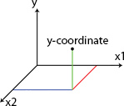








































Y
X2
Split 1
Split 3
200
Split 2
170
Split 4
20
40
X1

Slide 43


Slide 44


X2
Split 1
20
X1

Slide 45
X1 < 20
Yes
No

Slide 46
X2
Split 1
Split 2
170
20
X1

Slide 47
X1 < 20
Yes
No

Slide 48
X1 < 20
Yes
No
X2 < 170
Yes
No

Slide 49
X2
Split 1
Split 3
200
Split 2
170
20
X1

Slide 50
X1 < 20
Yes
No
X2 < 170
Yes
No

Slide 51
X1 < 20
Yes
No
X2 < 200
X2 < 170
Yes
No
Yes
No

Slide 52
X2
Split 1
Split 3
200
Split 2
170
Split 4
20
40
X1

Slide 53
X1 < 20
Yes
No
X2 < 200
X2 < 170
Yes
No
Yes
No

Slide 54
X1 < 20
Yes
No
X2 < 200
X2 < 170
Yes
No
Yes
No
X1 < 40
Yes
No

Slide 55


Y
X2
Split 1
65.7
Split 3
1023
200
Split 2
170
300.5
-64.1
0.7
Split 4
20
40
X1

Slide 56
X1 < 20
Yes
No
X2 < 200
X2 < 170
Yes
No
Yes
No
X1 < 40
Yes
No

Slide 57
X1 < 20
Yes
No
X2 < 200
X2 < 170
Yes
No
Yes
No
300.5
65.7
X1 < 40
1023
Yes
No
-64.1
0.7

Slide 59



Slide 60
STEP 1: Pick at random K data points from the Training set.
STEP 2: Build the Decision Tree associated to these K data points.
STEP 3: Choose the number Ntree of trees you want to build and repeat STEPS 1 & 2
STEP 4: For a new data point, make each one of your Ntree trees predict the value of Y to for the data point in question, and assign the new data point the average across all of the predicted Y values.

Slide 61


Classification

Slide 62

















Classification?
Classification: a Machine Learning technique to identify the category of new observations based on training data.
Likely to stay
Likely to leave
Dogs
Cats

Slide 63
Logistic Regression

Slide 64





Logistic Regression
Logistic regression: predict a categorical dependent variable from a number of independent variables.
𝑦 [yes/no]
(Took up offer?)
~
YES
YES
81%
Will purchase health insurance: Yes / No
Age
≥ 50%
< 50%
42%
𝑝
ln
= 𝑏₀ + 𝑏₁𝑋₁
NO
1 − 𝑝
NO
18
35 45
60
𝑋_{i} [yrs] (Age)

Slide 65


Logistic Regression
Logistic Regression
~
Will purchase health insurance: Yes / No
Age
Income
Level of Education
Family or Single
𝑝
ln
= 𝑏₀ + 𝑏₁𝑋₁ +𝑏₂𝑋₂ + 𝑏₃𝑋₃ + 𝑏₄𝑋₄
1 − 𝑝

Slide 66
Maximum Likelihood

Slide 67


Maximum Likelihood
𝑦 [yes/no]
(Took up offer?)
𝑦 [yes/no]
(Took up offer?)
YES
YES
_{0.920.95} 0.98
1- 0.96
1-0.58
0.54
1- 0.10
1- 0.04
0.03
1- 0.01
NO
NO
18
60
𝑋_{i} [yrs] (Age)
18
60
𝑋_{i} [yrs] (Age)
Likelihood = 0.03 x 0.54 x 0.92 x 0.95 x 0.98 x (1 – 0.01) x (1 – 0.04) x (1 – 0.10) x (1 – 0.58) x (1 – 0.96)
Likelihood = 0.00019939

Slide 68
Maximum Likelihood
𝑦 [yes/no]
(Took up offer?)
Likelihood = 0.00007418
Likelihood = 0.00012845
YES
Likelihood = 0.00016553
Likelihood = 0.00019939
Best Curve <= Maximum Likelihood
NO
18
60
𝑋_{i} [yrs] (Age)

Slide 69




Slide 70























Before K-NN
After K-NN
X2
x2
Category 2
Category 2
New data point
K-NN
New data point assigned to Category 1
Category 1
Category 1
x1
x1

Slide 71
STEP 1: Choose the number K of neighbors
STEP 2: Take the K nearest neighbors of the new data point, according to the Euclidean distance
STEP 3: Among these K neighbors, count the number of data points in each category
STEP 4: Assign the new data point to the category where you counted the most neighbors
Your Model is Ready

Slide 72















STEP 1: Choose the number K of neighbors: K = 5
x2
Category 2
New data point
Category 1
x1

Slide 73
P2(x2,y2)
y
y2
y1
P1(x1,y1)
x1
x2
x

Slide 74






x2
Category 2
Category 1: 3 neighbors
Category 2: 2 neighbors
New data point
Category 1
x1

Slide 75


Slide 76
x2
x1

Slide 77


Maximum Margin
x2
Support Vectors
x1

Slide 78


Maximum Margin
x2
Positive Hyperplane
Maximum Margin Hyperplane
(Maximum Margin Classifier)
Support Vectors
Negative Hyperplane
x1

Slide 80


Slide 81

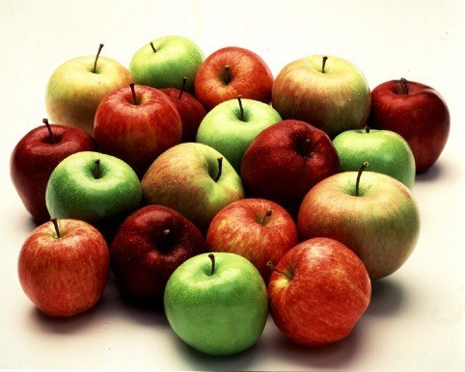
x2
x1

Slide 82

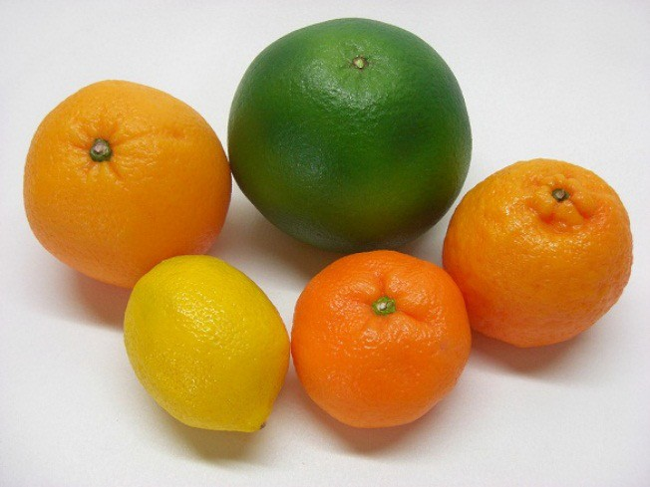
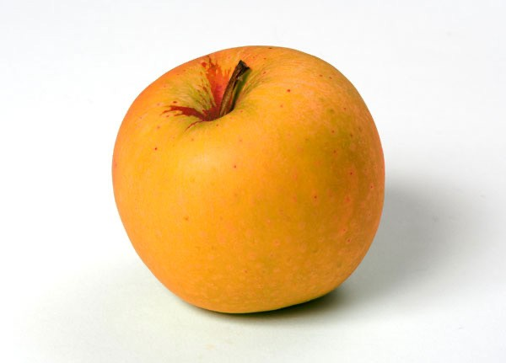
x2
Support Vectors
x1

Slide 84




































Linearly Separable
Not Linearly Separable
x2
x2
x1
x1

Slide 85



Slide 86


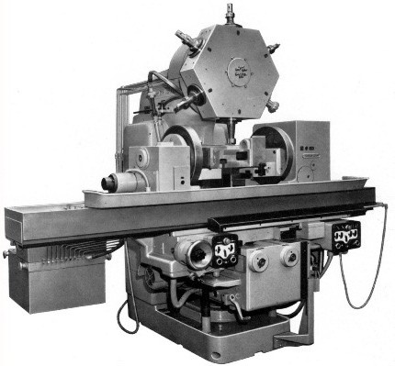

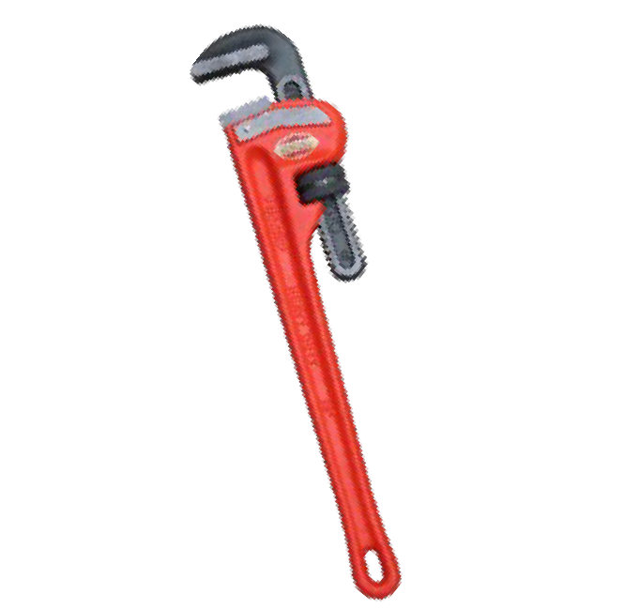



m1 m1 m1 m1 m1 m1 m1 m1 m1 m1
m1 m1 m1
m2 m2 m2 m2 m2 m2 m2 m2 m2 m2

Slide 87




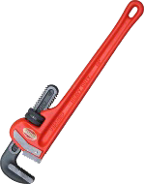

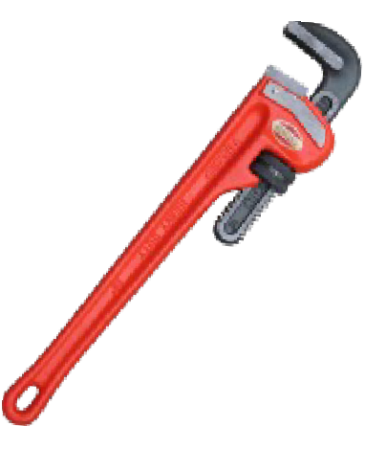

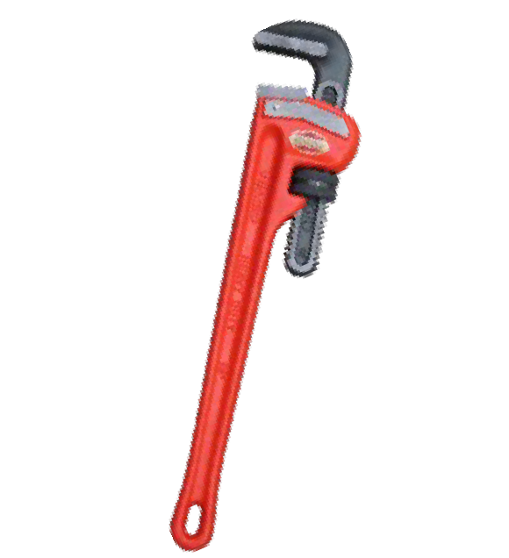

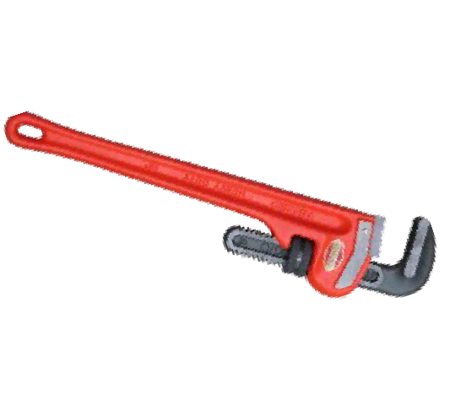
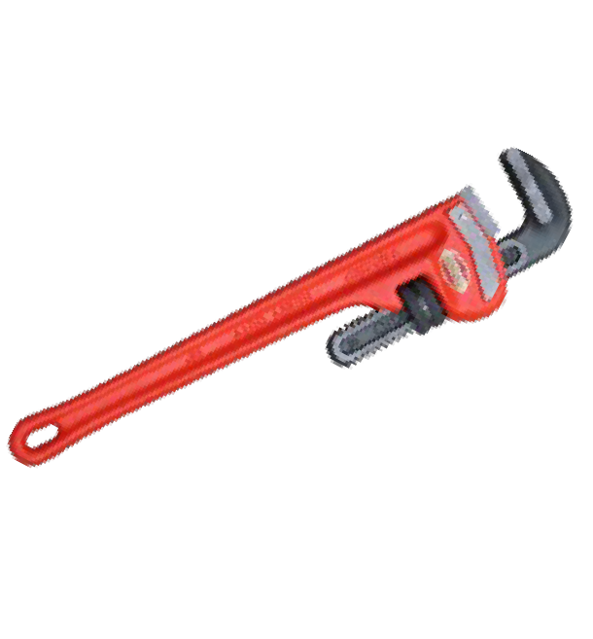





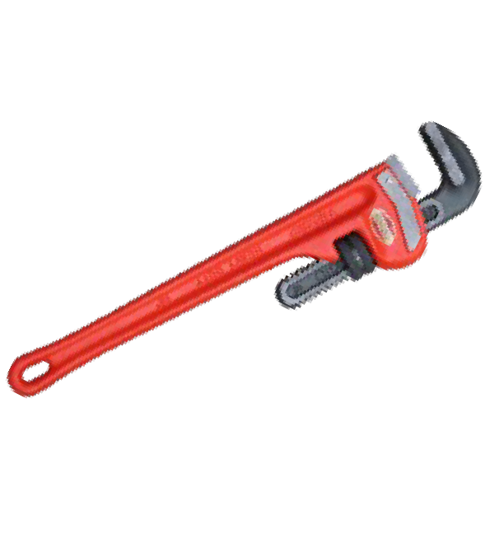


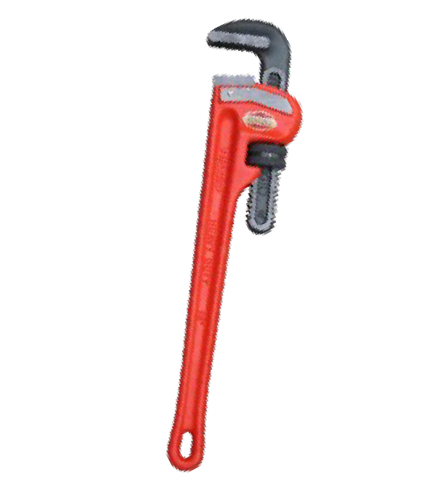









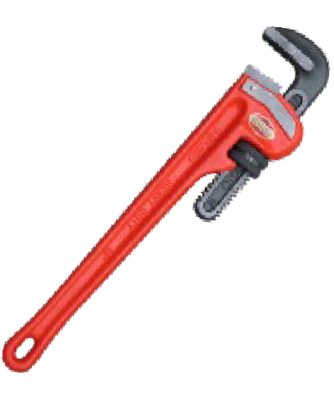









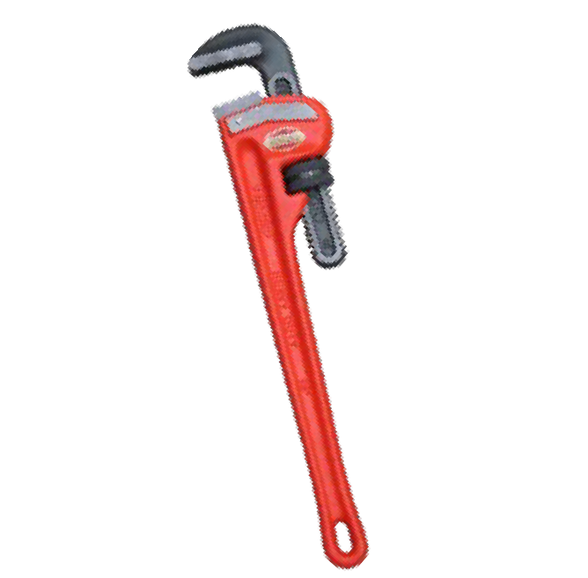




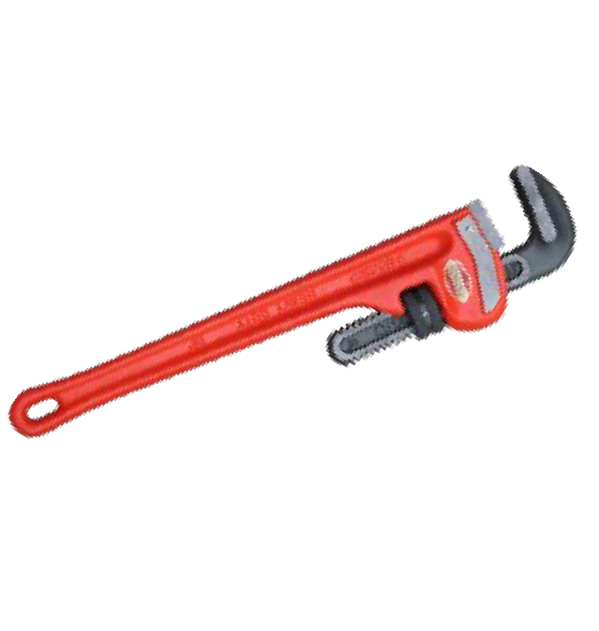







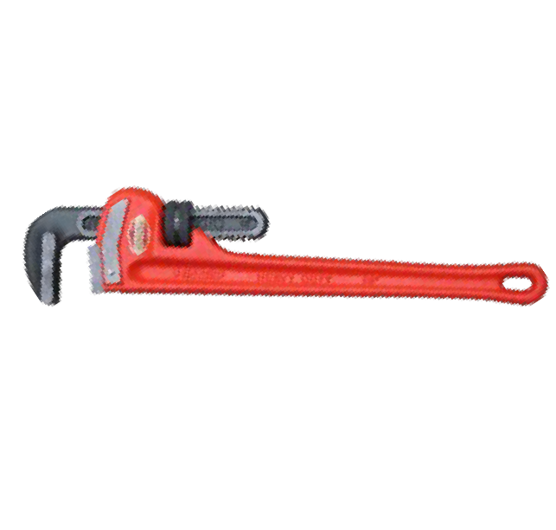


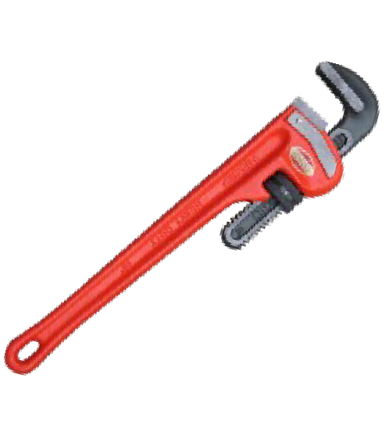



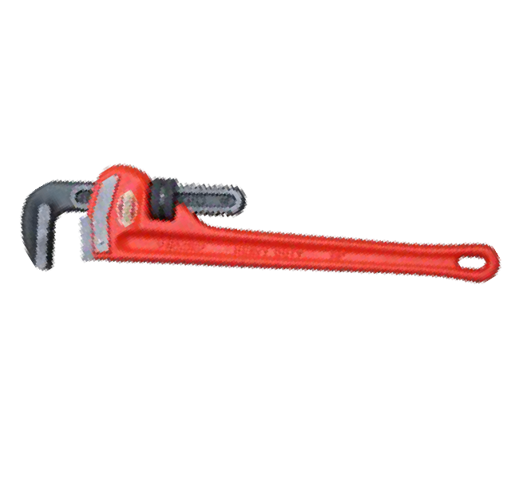


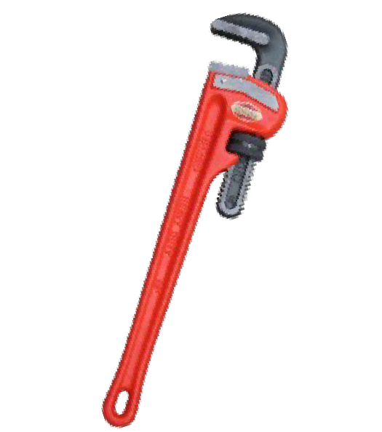
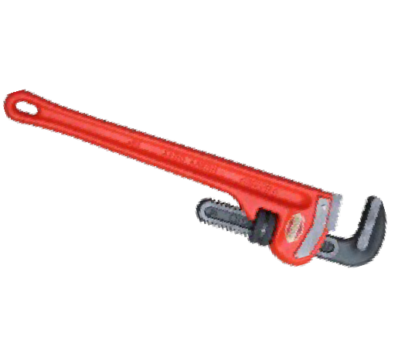




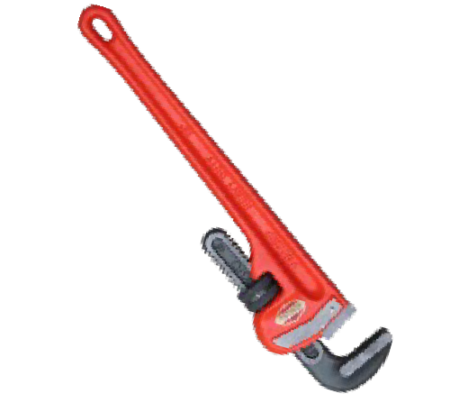



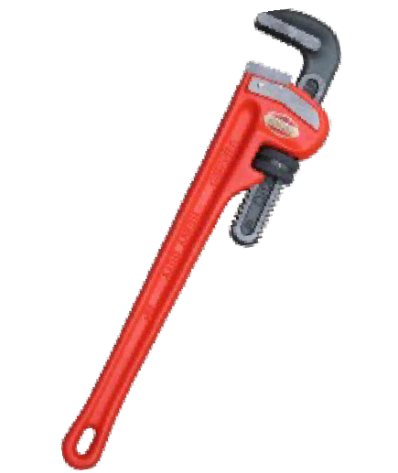














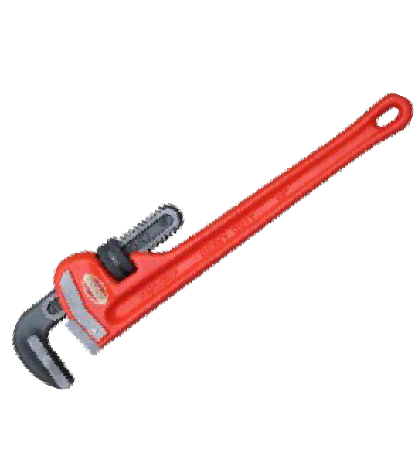
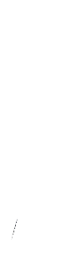








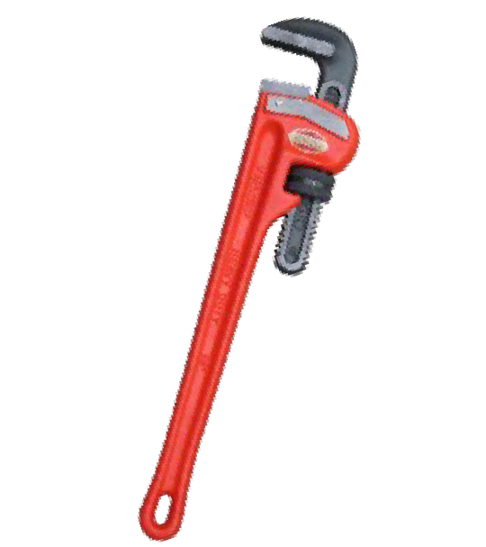








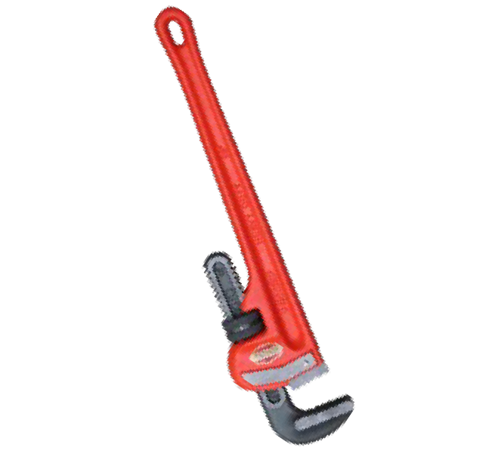





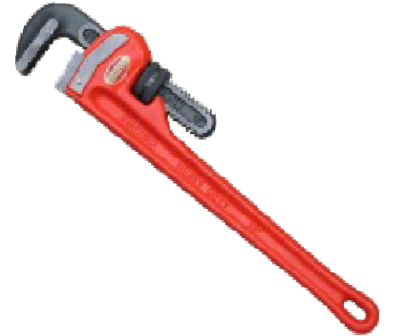


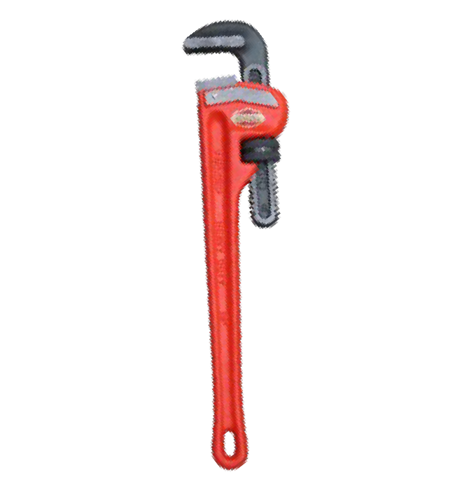



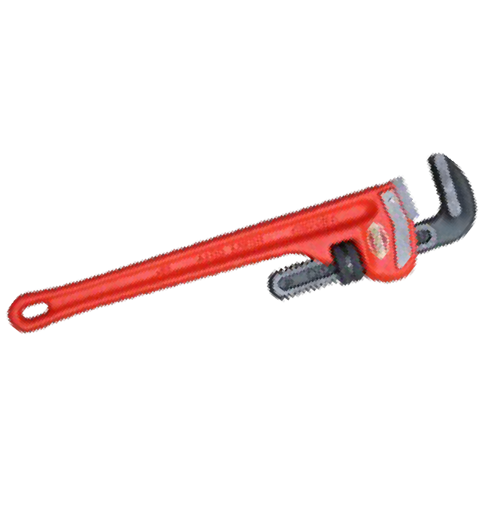





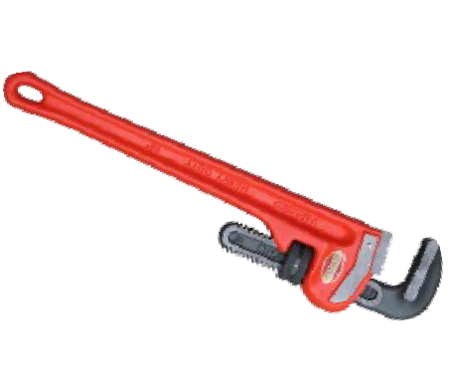











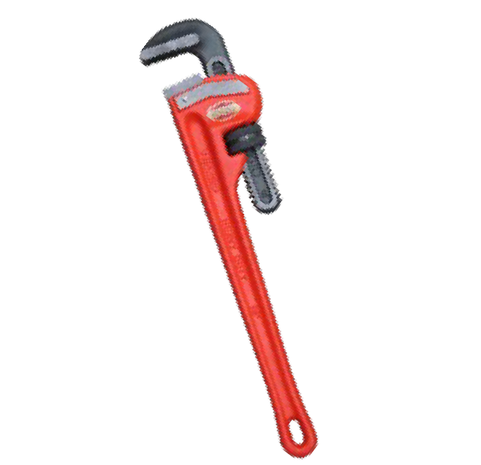








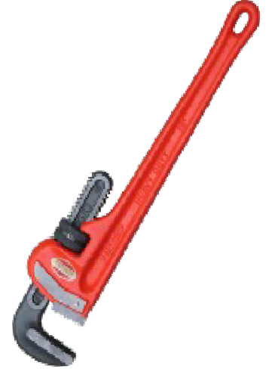
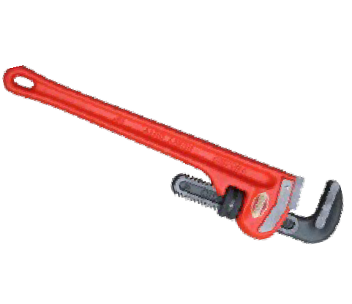













Slide 88







Slide 89
m2

Slide 90

m2

Slide 91
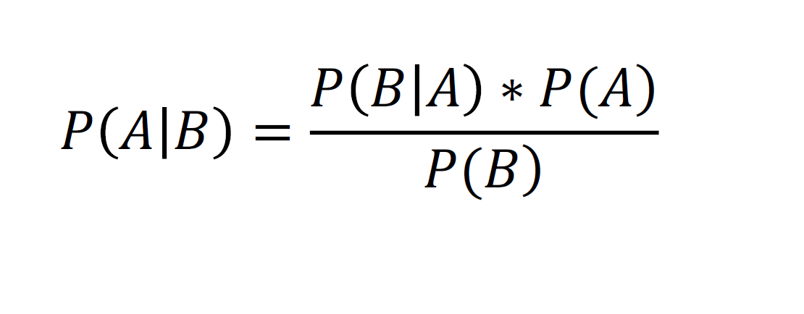
_{𝑃 𝐴 𝐵 =} 𝑃 𝐵 𝐴 ∗ 𝑃(𝐴)
𝑃(𝐵)

Slide 92







Slide 93



Slide 95




Slide 96











Slide 97

















Slide 98



Slide 99



















Slide 100






Slide 101




Slide 103


Slide 104



_{𝑃 𝐴 𝐵 =} 𝑃 𝐵 𝐴 ∗ 𝑃(𝐴)
𝑃(𝐵)

Slide 105

















Salary
X2
CaDtreivgeosry 2
CWataelgkosry 1
Age
X1

Slide 106

Salary
Drives
Walks
New data point
Age

Slide 107



Slide 108
_{𝑃 𝐴 𝐵 =} 𝑃 𝐵 𝐴 ∗ 𝑃(𝐴)
𝑃(𝐵)

Slide 109


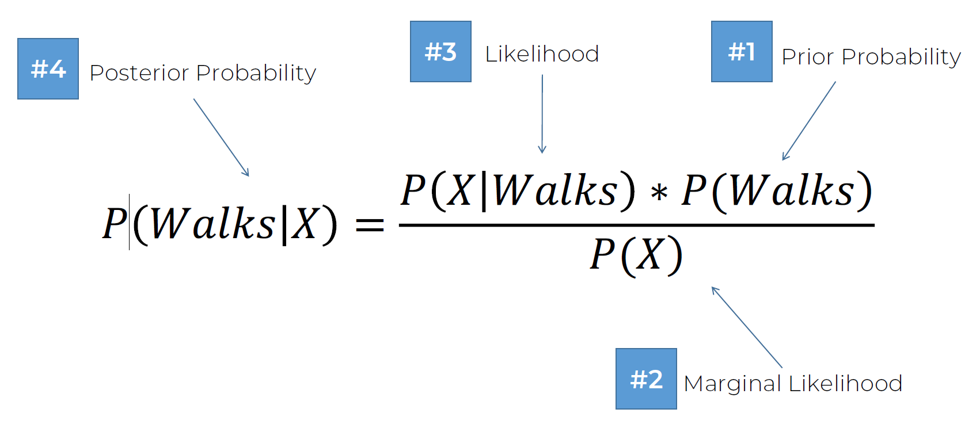
#3
#1
#4
Likelihood
Prior Probability
Posterior Probability
_{𝑃 𝑊𝑎𝑙𝑘𝑠 𝑋 =} 𝑃 𝑋 𝑊𝑎𝑙𝑘𝑠 ∗ 𝑃(𝑊𝑎𝑙𝑘𝑠)
𝑃(𝑋)
#2
Marginal Likelihood

Slide 110

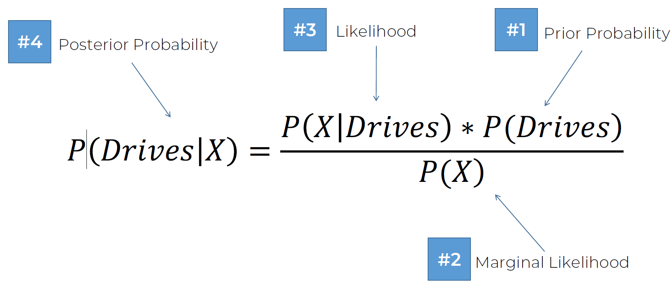
#3
#1
#4
Likelihood
Prior Probability
Posterior Probability
_{𝑃 𝐷𝑟𝑖𝑣𝑒𝑠 𝑋 =} 𝑃 𝑋 𝐷𝑟𝑖𝑣𝑒𝑠 ∗ 𝑃(𝐷𝑟𝑖𝑣𝑒𝑠)
𝑃(𝑋)
#2
Marginal Likelihood

Slide 111

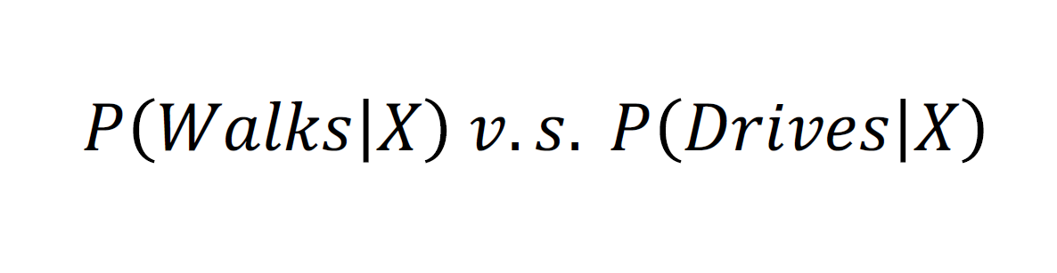
𝑃 𝑊𝑎𝑙𝑘𝑠 𝑋 𝑣. 𝑠. 𝑃 𝐷𝑟𝑖𝑣𝑒𝑠 𝑋

Slide 112



Slide 113


Salary
Drives
Walks
Age

Slide 114




_{𝑃(𝑊𝑎𝑙𝑘𝑠) =} 𝑁𝑢𝑚𝑏𝑒𝑟 𝑜𝑓 𝑊𝑎𝑙𝑘𝑒𝑟𝑠
Salary
Drives
𝑇𝑜𝑡𝑎𝑙 𝑂𝑏𝑠𝑒𝑟𝑣𝑎𝑡𝑖𝑜𝑛𝑠
₌ 10
Walks
𝑃 𝑊𝑎𝑙𝑘𝑠
30
Age

Slide 115




#3
#4
Likelihood
#1
Prior Probability
Posterior Probability
_{𝑃 𝑊𝑎𝑙𝑘𝑠 𝑋 =} 𝑃 𝑋 𝑊𝑎𝑙𝑘𝑠 ∗ 𝑃(𝑊𝑎𝑙𝑘𝑠)
𝑃(𝑋)
#2
Marginal Likelihood

Slide 116


_{𝑃(𝑋) =} 𝑁𝑢𝑚𝑏𝑒𝑟 𝑜𝑓 𝑆𝑖𝑚𝑖𝑙𝑎𝑟 𝑂𝑏𝑠𝑒𝑟𝑣𝑎𝑡𝑖𝑜𝑛𝑠
Salary
Drives
𝑇𝑜𝑡𝑎𝑙 𝑂𝑏𝑠𝑒𝑟𝑣𝑎𝑡𝑖𝑜𝑛𝑠
₌ 4
Walks
𝑃 𝑋
30
Age

Slide 117



#3
#4
Likelihood
#1
Prior Probability
Posterior Probability
_{𝑃 𝑊𝑎𝑙𝑘𝑠 𝑋 =} 𝑃 𝑋 𝑊𝑎𝑙𝑘𝑠 ∗ 𝑃(𝑊𝑎𝑙𝑘𝑠)
𝑃(𝑋)
#2
Marginal Likelihood

Slide 118







𝑁𝑢𝑚𝑏𝑒𝑟 𝑜𝑓 𝑆𝑖𝑚𝑖𝑙𝑎𝑟
𝑂𝑏𝑠𝑒𝑟𝑣𝑎𝑡𝑖𝑜𝑛𝑠
Salary
Drives
𝐴𝑚𝑜𝑛𝑔 𝑡ℎ𝑜𝑠𝑒 𝑤ℎ𝑜 𝑊𝑎𝑙𝑘
𝑃(𝑋|𝑊𝑎𝑙𝑘𝑠) =
𝑇𝑜𝑡𝑎𝑙 𝑛𝑢𝑚𝑏𝑒𝑟 𝑜𝑓 𝑊𝑎𝑙𝑘𝑒𝑟𝑠
Walks
₌ 3
𝑃 𝑋|𝑊𝑎𝑙𝑘𝑠
10
Age

Slide 119



#3 Likelihood
#4
#1
Prior Probability
Posterior Probability
_{𝑃 𝑊𝑎𝑙𝑘𝑠 𝑋 =} 𝑃 𝑋 𝑊𝑎𝑙𝑘𝑠 ∗ 𝑃(𝑊𝑎𝑙𝑘𝑠)
𝑃(𝑋)
#2
Marginal Likelihood

Slide 120
#3 Likelihood
#4
#1
Prior Probability
Posterior Probability
3 ∗ 10
𝑃 𝑊𝑎𝑙𝑘𝑠 𝑋 = ¹⁰ ₄ ³⁰ = 0.75
30
#2
Marginal Likelihood

Slide 121






Slide 122

#3
#1
#4
Likelihood
Prior Probability
Posterior Probability
_{𝑃 𝐷𝑟𝑖𝑣𝑒𝑠 𝑋 =} 𝑃 𝑋 𝐷𝑟𝑖𝑣𝑒𝑠 ∗ 𝑃(𝐷𝑟𝑖𝑣𝑒𝑠)
𝑃(𝑋)
#2
Marginal Likelihood

Slide 123


#3 Likelihood
#4
#1
Prior Probability
Posterior Probability
1 ∗ 20
𝑃 𝐷𝑟𝑖𝑣𝑒𝑠 𝑋 = ²⁰ ₄ ³⁰ = 0.25
30
#2
Marginal Likelihood

Slide 124





Slide 125
𝑃 𝑊𝑎𝑙𝑘𝑠 𝑋 𝑣. 𝑠. 𝑃 𝐷𝑟𝑖𝑣𝑒𝑠 𝑋

Slide 126
0.75 𝑣. 𝑠. 0.25

Slide 127
0.75 > 0.25

Slide 128

𝑃 𝑊𝑎𝑙𝑘𝑠 𝑋
> 𝑃 𝐷𝑟𝑖𝑣𝑒𝑠 𝑋

Slide 129
Salary
Drives
Walks
New data point
Age

Slide 130

Salary
Drives
Walks
New data point
Age

Slide 131




Slide 132

#3
#1
#4
Likelihood
Prior Probability
Posterior Probability
_{𝑃 𝐷𝑟𝑖𝑣𝑒𝑠 𝑋 =} 𝑃 𝑋 𝐷𝑟𝑖𝑣𝑒𝑠 ∗ 𝑃(𝐷𝑟𝑖𝑣𝑒𝑠)
𝑃(𝑋)
#2
Marginal Likelihood

Slide 133
Salary
Drives
Walks
Age

Slide 134

_{𝑃(𝐷𝑟𝑖𝑣𝑒𝑠) =} 𝑁𝑢𝑚𝑏𝑒𝑟 𝑜𝑓 𝐷𝑟𝑖𝑣𝑒𝑟𝑠
Salary
Drives
𝑇𝑜𝑡𝑎𝑙 𝑂𝑏𝑠𝑒𝑟𝑣𝑎𝑡𝑖𝑜𝑛𝑠
₌ 20
Walks
𝑃 𝐷𝑟𝑖𝑣𝑒𝑠
30
Age

Slide 135

#3
#4
Likelihood
#1
Prior Probability
Posterior Probability
_{𝑃 𝐷𝑟𝑖𝑣𝑒𝑠 𝑋 =} 𝑃 𝑋 𝐷𝑟𝑖𝑣𝑒𝑠 ∗ 𝑃(𝐷𝑟𝑖𝑣𝑒𝑠)
𝑃(𝑋)
#2
Marginal Likelihood

Slide 136
_{𝑃(𝑋) =} 𝑁𝑢𝑚𝑏𝑒𝑟 𝑜𝑓 𝑆𝑖𝑚𝑖𝑙𝑎𝑟 𝑂𝑏𝑠𝑒𝑟𝑣𝑎𝑡𝑖𝑜𝑛𝑠
Salary
Drives
𝑇𝑜𝑡𝑎𝑙 𝑂𝑏𝑠𝑒𝑟𝑣𝑎𝑡𝑖𝑜𝑛𝑠
₌ 4
Walks
𝑃 𝑋
30
Age

Slide 137
#3
#4
Likelihood
#1
Prior Probability
Posterior Probability
_{𝑃 (𝐷𝑟𝑖𝑣𝑒𝑠|𝑋)=} 𝑃(𝑋|𝐷𝑟𝑖𝑣𝑒𝑠) ∗ 𝑃(𝐷𝑟𝑖𝑣𝑒𝑠)
𝑃(𝑋)
#2
Marginal Likelihood

Slide 138



𝑁𝑢𝑚𝑏𝑒𝑟 𝑜𝑓 𝑆𝑖𝑚𝑖𝑙𝑎𝑟
𝑂𝑏𝑠𝑒𝑟𝑣𝑎𝑡𝑖𝑜𝑛𝑠
Salary
Drives
𝐴𝑚𝑜𝑛𝑔 𝑡ℎ𝑜𝑠𝑒 𝑤ℎ𝑜 𝑊𝑎𝑙𝑘
𝑃(𝑋|𝐷𝑟𝑖𝑣𝑒𝑠) =
𝑇𝑜𝑡𝑎𝑙 𝑛𝑢𝑚𝑏𝑒𝑟 𝑜𝑓 𝑊𝑎𝑙𝑘𝑒𝑟𝑠
Walks
₌ 1
𝑃 𝑋|𝐷𝑟𝑖𝑣𝑒𝑠
20
Age

Slide 139
#3 Likelihood
#4
#1
Prior Probability
Posterior Probability
_{𝑃 (𝐷𝑟𝑖𝑣𝑒𝑠|𝑋)=} 𝑃(𝑋|𝐷𝑟𝑖𝑣𝑒𝑠) ∗ 𝑃(𝐷𝑟𝑖𝑣𝑒𝑠)
𝑃(𝑋)
#2
Marginal Likelihood

Slide 140
#3 Likelihood
#4
#1
Prior Probability
Posterior Probability
1 ∗ 20
𝑃 𝐷𝑟𝑖𝑣𝑒𝑠 𝑋 = ²⁰ ₄ ³⁰ = 0.25
30
#2
Marginal Likelihood

Slide 143








Slide 145
Salary
Drives
Walks
New data point
Age

Slide 146



Slide 147


_{𝑃(𝑋) =} 𝑁𝑢𝑚𝑏𝑒𝑟 𝑜𝑓 𝑆𝑖𝑚𝑖𝑙𝑎𝑟 𝑂𝑏𝑠𝑒𝑟𝑣𝑎𝑡𝑖𝑜𝑛𝑠
Salary
Drives
𝑇𝑜𝑡𝑎𝑙 𝑂𝑏𝑠𝑒𝑟𝑣𝑎𝑡𝑖𝑜𝑛𝑠
₌ 4
Walks
𝑃 𝑋
30
NOTE: Same both times
Age

Slide 148

#3
#1
#4
Likelihood
Prior Probability
Posterior Probability
#2
Marginal Likelihood

Slide 149
#3
#1
#4
Likelihood
Prior Probability
Posterior Probability
_{𝑃 (𝐷𝑟𝑖𝑣𝑒𝑠|𝑋)=} 𝑃(𝑋|𝐷𝑟𝑖𝑣𝑒𝑠) ∗ 𝑃(𝐷𝑟𝑖𝑣𝑒𝑠)
𝑃(𝑋)
#2
Marginal Likelihood

Slide 150


𝑃 𝑊𝑎𝑙𝑘𝑠 𝑋
𝑣. 𝑠.
𝑃 𝐷𝑟𝑖𝑣𝑒𝑠 𝑋

Slide 151


𝑃 𝑋 𝑊𝑎𝑙𝑘𝑠 ∗ 𝑃(𝑊𝑎𝑙𝑘𝑠)
𝑃(𝑋)
𝑃 𝑋 𝐷𝑟𝑖𝑣𝑒𝑠 ∗ 𝑃(𝐷𝑟𝑖𝑣𝑒𝑠)
𝑃(𝑋)
𝑣. 𝑠.

Slide 152




Slide 153
𝑃 𝑊𝑎𝑙𝑘𝑠 𝑋 𝑣. 𝑠. 𝑃 𝐷𝑟𝑖𝑣𝑒𝑠 𝑋

Slide 154
0.75 𝑣. 𝑠. 0.25

Slide 155
0.75 > 0.25

Slide 156
𝑃 𝑊𝑎𝑙𝑘𝑠 𝑋
> 𝑃 𝐷𝑟𝑖𝑣𝑒𝑠 𝑋

Slide 159























x2
x1

Slide 160
x2
₆₀ Split 1
x1

Slide 161
x2
Split 2
60
Split 1
50
x1

Slide 162
x2
Split 2
60
Split 3
Split 1
50
70
x1

Slide 163
x2
Split 2
60
Split 3
Split 1
Split 4
50
70
x1

Slide 165

x2
60
Split 1
x1

Slide 166
X2 < 60
Yes
No

Slide 167

x2
Split 2
60
Split 1
50
x1

Slide 168
X2 < 60
Yes
No
X1 < 50
Yes
No

Slide 169

x2
Split 2
60
Split 3
Split 1
50
70
x1

Slide 170
X2 < 60
Yes
No
X1 < 70
X1 < 50
Yes
No
Yes
No

Slide 171

x2
Split 2
60
Split 3
Split 1
20
Split 4
50
70
x1

Slide 172
X2 < 60
Yes
No
X1 < 70
X1 < 50
Yes
No
Yes
No
X2 < 20
Yes
No

Slide 173















Slide 176
STEP 1: Pick at random K data points from the Training set.
STEP 2: Build the Decision Tree associated to these K data points.
STEP 3: Choose the number Ntree of trees you want to build and repeat STEPS 1 & 2
STEP 4: For a new data point, make each one of your Ntree trees predict the category to which the data points belongs, and assign the new data point to the category that wins the majority vote.

Slide 177





Slide 178
































ŷ (Predicted DV)
p̂ (Probability)
y (Actual DV)
ŷ = 1
ŷ = 1
1
0.5
X
ŷ = 0
ŷ = 0
20
30 40
50

Slide 179







y (Actual DV)
p̂ (Probability)
#2
#4
1
0.5
X
#1
#3

Slide 180









False Posi.ve (Type I Error)
y (Actual DV)
p̂ (Probability)
ŷ (Predicted DV)
#2
#4
1
0.5
X
#1
#3
False Nega.ve (Type II Error)
Fin.

Slide 181
Confusion Matrix & Accuracy

Slide 182


Confusion Matrix & Accuracy
 |  | Prediction
 |  | NEG | POS
Actual | NEG | TRUE NEG | FALSE POS
 | POS | FALSE NEG | TRUE POS
Type II Error
(False Negatives)
Type I Error
(False Positives)
Image source: nature.com

Slide 183
Confusion Matrix & Accuracy
 |  | Prediction
 |  | NEG | POS
Actual | NEG | 43 | 12
 | POS | 4 | 41
Accuracy Rate and Error Rate:
_{𝐴𝑅 =} 𝐶𝑜𝑟𝑟𝑒𝑐𝑡 ₌ 𝑇𝑁 + 𝑇𝑃 ₌ 84 _{= 84%}
𝑇𝑜𝑡𝑎𝑙 𝑇𝑜𝑡𝑎𝑙 100
_{𝐸𝑅 =} 𝐼𝑛𝑐𝑜𝑟𝑟𝑒𝑐𝑡 ₌ 𝐹𝑃 + 𝐹𝑁 ₌ 16 _{= 16%}
𝑇𝑜𝑡𝑎𝑙 𝑇𝑜𝑡𝑎𝑙 100
Type II Error
(False Negatives)
Type I Error
(False Positives)

Slide 184




Additional Reading
Understanding the Confusion Matrix from Scikit learn
Samarth Agrawal (2021) Link:
https://towardsdatascience.com/understanding-the- confusion-matrix-from-scikit-learn-c51d88929c79

Slide 185



Slide 186



ŷ (Predicted DV)
Scenario 1:
0
1
Accuracy Rate = Correct / Total AR = 9,800/10,000 = 98%
0
y (Actual DV)
9,700 150
1
50
100

Slide 187
ŷ (Predicted DV)
Scenario 1:
0
1
Accuracy Rate = Correct / Total AR = 9,800/10,000 = 98%
0
y (Actual DV)
9,850
0
Scenario 2:
Accuracy Rate = Correct / Total AR = 9,850/10,000 = 98.5%
1
150
0

Slide 188

Clustering

Slide 189
What is Clustering?
Clustering – grouping unlabelled data

Slide 190






What is Clustering?
Supervised Learning
(e.g. Regression, Classification)
Unsupervised Learning
(e.g. Clustering)
Image source: mdpi.com/2073-8994/10/12/734

Slide 191
What is Clustering?
Spending Score
Spending Score
Clustering
Annual Income $
Annual Income $

Slide 192

K-Means Clustering

Slide 193














K-Means Clustering

Slide 194












K-Means Clustering

Slide 195











K-Means Clustering

Slide 196









K-Means Clustering

Slide 197








K-Means Clustering

Slide 198








K-Means Clustering

Slide 199








K-Means Clustering

Slide 200

K-Means Clustering

Slide 201
K-Means Clustering

Slide 202
K-Means Clustering

Slide 203



K-Means Clustering

Slide 204
K-Means Clustering

Slide 205

K-Means Clustering

Slide 206
K-Means Clustering

Slide 207

K-Means Clustering

Slide 208

K-Means Clustering

Slide 209


K-Means Clustering

Slide 210
K-Means Clustering

Slide 211






K-Means Clustering

Slide 212









K-Means Clustering

Slide 213







K-Means Clustering

Slide 214
The Elbow Method

Slide 215

























The Elbow Method

Slide 216
The Elbow Method
Within Cluster Sum of Squares:
...

Slide 217






The Elbow Method

Slide 218









The Elbow Method
C1
Cluster 1

Slide 219
















The Elbow Method
C1
Cluster 2
Cluster 1
C2

Slide 220








The Elbow Method
C2 Cluster 2
C1
Cluster 1
Cluster 3
C3

Slide 221

The Elbow Method
The Elbow Method
Optimal number of clusters

Slide 222
K-Means++

Slide 223

K-Means++
Cluster 2
K-Means
Cluster 1
Cluster 3
Different results
Cluster 2
K-Means
Cluster 3
Cluster 1

Slide 224
K-Means++
K-Means++ Initialization Algorithm:
Step 1: Choose first centroid at random among data points
Step 2: For each of the remaining data points compute the distance (D) to the nearest out of already selected centroids
Step 3: Choose next centroid among remaining data points using weighted random selection – weighted by D²
Step 4: Repeat Steps 2 and 3 until all k centroids have been selected Step 5: Proceed with standard k-means clustering

Slide 225


















K-Means++

Slide 226
K-Means++

Slide 227
K-Means++

Slide 228
K-Means++

Slide 229
K-Means++

Slide 230














K-Means++
Cluster 2
Cluster 1
Cluster 3

Slide 231
Thank You!

